Slide 1

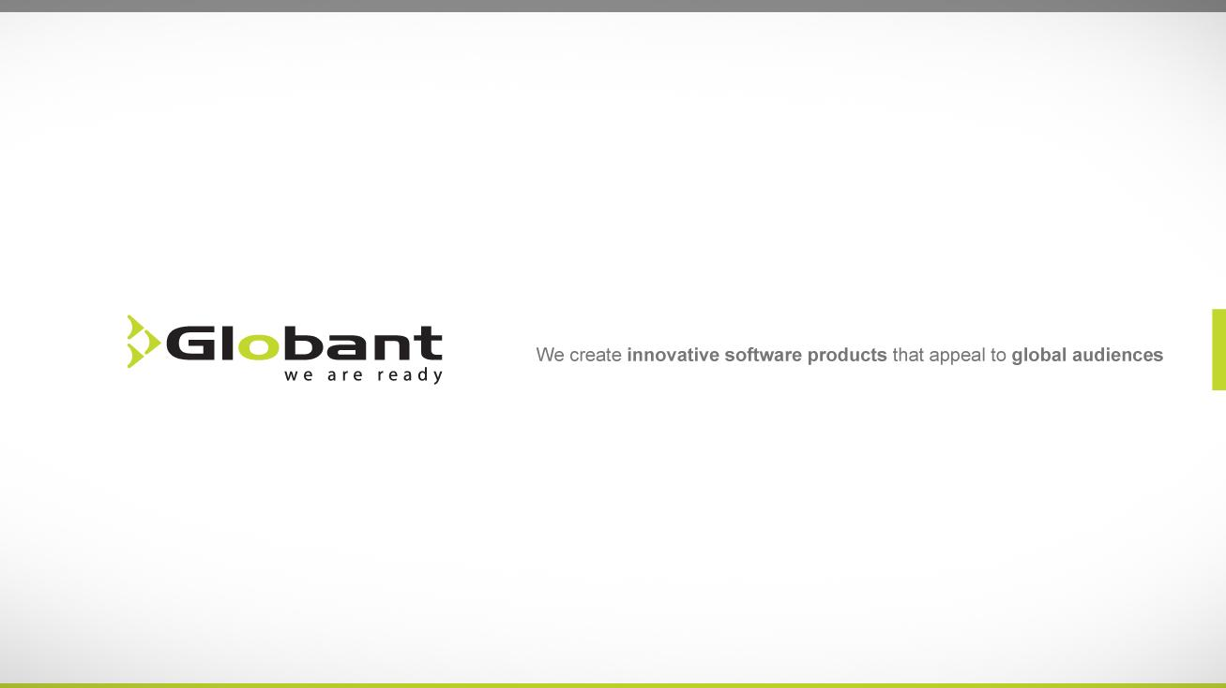

Slide 2
Exceptions

Slide 3



Topics
What is JDBC?
JDBC
Product Components
JDBC API Architecture
JDBC Architecture
JDBC Driver Types
JDBC API - Common JDBC Components
Querying a Database
Connect to the DB
Statement
Prepared Statement
Stored Procedure
Result Set
Close
Transaction

Slide 4
What is JDBC?
Java DataBase Connectivity (JDBC) is a standard that describes how to connect to and talk to a database from within a Java application.
JDBC is a layer of abstraction that allows users to choose between databases. It provides cross-DBMS connectivity to a wide range of SQL databases It allows you to access virtually any SQL database engine with the single JDBC API.
JDBC allows you to write database applications without having to concern yourself with the underlying details of a particular database.

Slide 5
JDBC – JDBC API
The JDBC API provides Java programmers with a uniform interface to a wide range of relational databases.
All Java database related classes and interfaces are packaged together in the API package of java.sql which includes both the JDBC interfaces and the JDBC driver manager.

Slide 6
JDBC – JDBC Driver
A JDBC driver is a set of Java classes that implement the JDBC interfaces and translate vendor-neutral JDBC calls to vendor-specific DBMS commands so that JDBC can talk to any specific SQL database.
JDBC drivers are provided by database vendors.
A JDBC driver can be pre-installed installed by downloading.
The JDBC driver must register with the JDBC driver manager. JDBC driver manager will connect to a given database upon requests from Java application

Slide 7
JDBC
The JDBC API is a Java API that can access any kind of tabular data, especially data stored in a Relational Database.
JDBC helps you to write Java applications that manage these three programming activities:
Connect to a data source, like a database
Send queries and update statements to the database
Retrieve and process the results received from the database in answer to your query

Slide 8
JDBC
The following simple code fragment gives a simple example of these three steps:
public void connectToAndQueryDatabase(String username, String password) {
Connection con = DriverManager.getConnection(
"jdbc:myDriver:myDatabase",username,password);
Statement stmt = con.createStatement();
ResultSet rs = stmt.executeQuery("SELECT a, b, c FROM Table1");
while (rs.next()) {
int x = rs.getInt("a");
String s = rs.getString("b");
float f = rs.getFloat("c");
}
}

Slide 9
JDBC
This short code fragment instantiates a DriverManager object to connect to a database driver and log into the database, instantiates a Statement object that carries your SQL language query to the database; instantiates a ResultSet object that retrieves the results of your query, and executes a simple while loop, which retrieves and displays those results. It's that simple.

Slide 10
JDBC Product Components
JDBC includes four components
The JDBC API — The JDBC™ API provides programmatic access to relational data from the Java™ programming language. Using the JDBC API, applications can execute SQL statements, retrieve results, and propagate changes back to an underlying data source. The JDBC API can also interact with multiple data sources in a distributed, heterogeneous environment.
The JDBC API is part of the Java platform, which includes the Java™ Standard Edition (Java™ SE ) and the Java™ Enterprise Edition (Java™ EE). The JDBC 4.0 API is divided into two packages: java.sql and javax.sql. Both packages are included in the Java SE and Java EE platforms.

Slide 11
JDBC Product Components
JDBC Driver Manager — The JDBC DriverManager class defines objects which can connect Java applications to a JDBC driver. DriverManager has traditionally been the backbone of the JDBC architecture. It is quite small and simple.
The Standard Extension packages javax.naming and javax.sql let you use a DataSource object registered with a Java Naming and Directory Interface™ (JNDI) naming service to establish a connection with a data source. You can use either connecting mechanism, but using a DataSource object is recommended whenever possible.

Slide 12
JDBC Product Components
JDBC Test Suite — The JDBC driver test suite helps you to determine that JDBC drivers will run your program. These tests are not comprehensive or exhaustive, but they do exercise many of the important features in the JDBC API.

Slide 13
JDBC Product Components
JDBC-ODBC Bridge — The Java Software bridge provides JDBC access via ODBC drivers. Note that you need to load ODBC binary code onto each client machine that uses this driver. As a result, the ODBC driver is most appropriate on a corporate network where client installations are not a major problem, or for application server code written in Java in a three-tier architecture.
This document uses the first two of these four JDBC components to connect to a database and then build a java program that uses SQL commands to communicate with a test Relational Database. The last two components are used in specialized environments to test web applications, or to communicate with ODBC-aware DBMSs.

Slide 14
What is JDBC?
Now, you can see:
01. What is JDBC
http://youtu.be/Y2_-cdImv2o

Slide 15
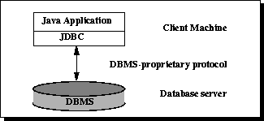
JDBC API Architecture
Two-tier Processing Models
In the two-tier model, a Java application talks directly to the data source. This requires a JDBC driver that can communicate with the particular data source being accessed. A user's commands are delivered to the database or other data source, and the results of those statements are sent back to the user.
The data source may be located on another machine to which the user is connected via a network. This is referred to as a client/server configuration, with the user's machine as the client, and the machine housing the data source as the server. The network can be an intranet, which, for example, connects employees within a corporation, or it can be the Internet

Slide 16
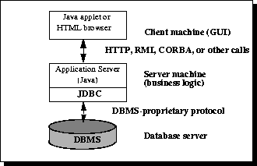
JDBC API Architecture
Three-tier Processing Models
In the three-tier model, commands are sent to a "middle tier" of services, which then sends the commands to the data source. The data source processes the commands and sends the results back to the middle tier, which then sends them to the user.
MIS directors find the three-tier model very attractive because the middle tier makes it possible to maintain control over access and the kinds of updates that can be made to corporate data. Another advantage is that it simplifies the deployment of applications. Finally, in many cases, the three-tier architecture can provide performance advantages.

Slide 17
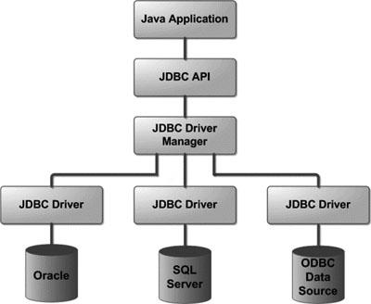
JDBC Architecture

Slide 18
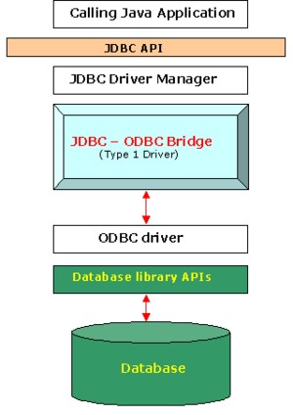
JDBC Driver Types
Type 1: JDBC-ODBC Driver
The JDBC-ODBC bridge type driver translates Java JDBC code to ODBC binary code (C++) which in turn translates it into DBMS commands for the target database.
This type driver must be installed at client site and can not be downloaded via network since it is not written purely in Java.
This driver is not very efficient because of the overhead of this additional layer.
If there is an ODBC driver available at client site this driver can be a good choice since ODBC driver is an open database connection driver to many vendor databases.
The type-1 driver lets you access any ODBC data source from a Java application. The name of the driver class is: sun.jdbc.odbc.JdbcOdbcDriver.
You can see that a JDBC/ODBC driver takes JDBC calls and translates them to ODBC calls., an ODBC driver (supports many vendor databases) in turn translates the ODBC calls to database specific calls.

Slide 19
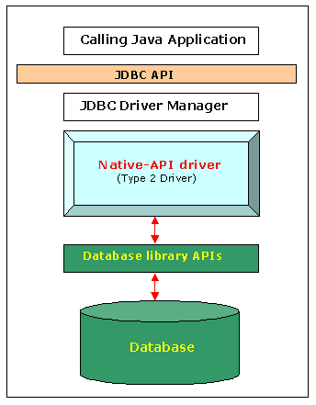
JDBC Driver Types
Type 2: Native API Drivers
The native-API partly-Java driver type uses Java code to call native (non-Java) code to a DBMS-specific API, jdbc:oracle:oci for oracle.jdbc.driver.OracleDriver is an example of such driver that Oracle provides. The vertical dash line indicates the division of client site and server site.
This type driver can make use of existing DBMS-specific drivers; therefore it is more efficient than a type-1 driver. Due to the use of native code on the client.
This type also requires prior installation of client software.
Compared with type-4 driver this type driver is called a fat driver.

Slide 20
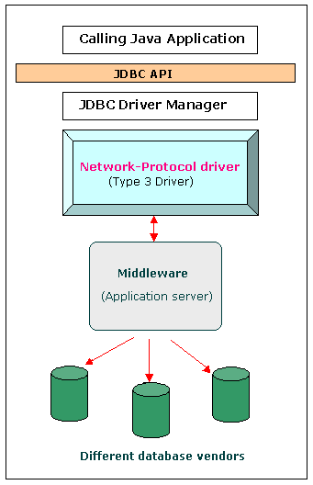
JDBC Driver Types
Type 3: Network-Protocol Driver
This net-protocol pure Java driver type translates JDBC calls into a DBMS-independent network protocol that is then translated to a specific DBMS protocol by the middleware.
This driver type uses pure-Java client software; the client driver is DBMS independent; but it needs a middle tier support.
This type diver is similar to a server-side driver since part of it resides on a middle-ware server as shown in figure

Slide 21
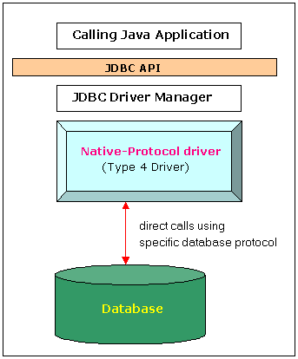
JDBC Driver Types
Type 4: Native-Protocol Driver
The DBMS-protocol pure-Java driver type translates JDBC calls into a network protocol that is used directly by the DBMS.
The advantage of this type is that it uses pure-Java client software; this type driver is platform independent and it is a thin driver, jdbc:oracle:thin for oracle.jdbc.driver.OracleDriver is an example of such type driver that Oracle provides.
The disadvantage is that the driver is vendor specific.

Slide 22
JDBC Driver Types
Now, you can see:
02. JDBC Driver
http://youtu.be/AhSxAlqyHhc

Slide 23
JDBC API – Common JDBC Components
DriverManager: This class manages a list of database drivers. Matches connection requests from the java application with the proper database driver using communication subprotocol. The first driver that recognizes a certain subprotocol under JDBC will be used to establish a database Connection.
Driver: This interface handles the communications with the database server. You will interact directly with Driver objects very rarely. Instead, you use DriverManager objects, which manages objects of this type. It also abstracts the details associated with working with Driver objects

Slide 24
JDBC API – Common JDBC Components
Connection: This interface with all methods for contacting a database. The connection object represents communication context, i.e., all communication with database is through connection object only.
Statement: You use objects created from this interface to submit the SQL statements to the database. Some derived interfaces accept parameters in addition to executing stored procedures.
ResultSet: These objects hold data retrieved from a database after you execute an SQL query using Statement objects. It acts as an iterator to allow you to move through its data.
SQLException: This class handles any errors that occur in a database application.

Slide 25
JDBC API – Querying a Database
Connect
Overview of Querying a Database With JDBC
Query
Process results
Close

Slide 26
Querying a Database – Connect
Stage 1: Connect
Connect
Connect to the database
Query
Process results
Close

Slide 27
Querying a Database – Connect to the DB
Stage 1: Connect
Make the connection
Connecting to your DBMS with the DriverManager class involves calling the method DriverManager.getConnection.
The method DriverManager.getConnection establishes a database connection. This method requires a database URL, which varies depending on your DBMS.
Connection con = DriverManager.getConnection( "jdbc:oracle:thin:@oracle-prod:1521:OPROD", username, passwd);
Connection con = DriverManager.getConnection( "jdbc:mysql//server:1521/OPROD", username, passwd);
Establishes connection to database by obtaining a Connection object

Slide 28
Querying a Database – Connect to the DB
In previous versions of JDBC, to obtain a connection, you first had to initialize your JDBC driver by calling the method Class.forName.
This methods required an object of type java.sql.Driver. Each JDBC driver contains one or more classes that implements the interface java.sql.Driver.
Class.forName("oracle.jdbc.driver.OracleDriver"); // Dynamically loads a driver class, for Oracle database
Class.forName(“mysql.jdbc.driver.OracleDriver"); // Dynamically loads a driver class, for MySQL database
The driver for Oracle is oracle.jdbc.driver.OracleDriver, and for MySQL Connector/J is com.mysql.jdbc.Driver.
See the documentation of your DBMS driver to obtain the name of the class that implements the interface java.sql.Driver.
Any JDBC 4.0 drivers that are found in your class path are automatically loaded. (However, you must manually load any drivers prior to JDBC 4.0 with the method Class.forName. Load and register the vendor specific driver

Slide 29
Querying a Database – Connect to the DB
Now, you can see:
03. Connect
04. Connection Singleton
http://youtu.be/III0cNNGKB0
http://youtu.be/AH9s_ahzF9U

Slide 30
Querying a Database – Connect to the DB
Now, you can see:
05. Static Sql
http://youtu.be/4Bez6eG3HkI

Slide 31
Querying a Database - Query
Stage 2: Query
Connect
Query
Create a statement
Process results
Query the database
Close

Slide 32
Querying a Database – Statement
Stage 2: Query
Create a Statement
A Statement is an interface that represents a SQL statement. You execute Statement objects, and they generate ResultSet objects, which is a table of data representing a database result set. You need a Connection object to create a Statement object.
For example:
Statement stmt = con.createStatement() ; // Creates a Statement object for sending SQL statements
Class.forName(“mysql.jdbc.driver.OracleDriver"); // Dynamically loads a driver class, for MySQL database

Slide 33
Querying a Database – Statement
There are three different kinds of statements:
Statement: Used to implement simple SQL statements with no parameters.
PreparedStatement: (Extends Statement.) Used for precompiling SQL statements that might contain input parameters.
CallableStatement: (Extends PreparedStatement.) Used to execute stored procedures that may contain both input and output parameters.

Slide 34
Querying a Database – Statement
Stage 2: Query
Query the database
To execute a query, call an execute method from Statement such as the following:
execute: Returns true if the first object that the query returns is a ResultSet object. Use this method if the query could return one or more ResultSet objects. Retrieve the ResultSet objects returned from the query by repeatedly calling Statement.getResultSet.
executeQuery: Returns one ResultSet object.
executeUpdate: Returns an integer representing the number of rows affected by the SQL statement. Use this method if you are using INSERT, DELETE, or UPDATE SQL statements.

Slide 35
Querying a Database – Statement
For example:
String createLehigh = "Create table Lehigh (SSN Integer not null, "+
"Name VARCHAR(32), Marks Integer)";
stmt.executeUpdate(createLehigh);
String insertLehigh = "Insert into Lehigh values (123456789,abc,100)";
stmt.executeUpdate(insertLehigh);
ResultSet rs = stmt.executeQuery(query);

Slide 36
Querying a Database – Connect to the DB
Now, you can see:
06. Insert
07. Delete
08. Update
http://youtu.be/Dpx09ZkdhLw
http://youtu.be/7N2KXef4CiI
http://youtu.be/Iz26i1ZUzRo

Slide 37
Querying a Database – Prepared Statement
It enables a SQL statement to contain parameters like a function definition, and you can execute a single statement repeatedly with different values for those parameters.
PreparedStatement ps= c.prepareStatement(
"UPDATE account " + "SET balance = ? " + "WHERE id = ?");
int i;
for(i=0; i<accounts.length; i++) {
ps.setFloat(1, accounts[i].getBalance( ));
ps.setInt(2, accounts[i].getId( ));
ps.execute( );
ps.clearParameters( )
}

Slide 38
Prepared Statement
Now, you can see:
09. Prepared Statement
http://youtu.be/LAgiayhUO08

Slide 39
Querying a Database – Stored Procedures
While prepared statements let you access similar database queries through a single PreparedStatement object, stored procedures attempt to take the "black box" concept for database access one step further.
A stored procedure is built inside the database before you run your application. You access that stored procedure by name at runtime. In other words, a stored procedure is almost like a method you call in the database.

Slide 40
Querying a Database – Stored Procedures
Because the procedure is precompiled in the database for most database engines, it executes much faster than dynamic SQL.
Syntax errors in the stored procedure can be caught at compile time rather than at runtime.
Java developers need to know only the name of the procedure and its inputs and outputs.

Slide 41
Querying a Database – Stored Procedures
How to call the stored procedure in Java?
try {
CallableStatement statement;
int i;
statement = c.prepareCall("{call sp_interest[(?,?)]}");
statement.registerOutParameter(2, java.sql.Types.FLOAT);
for(i=1; i<accounts.length; i++) {
statement.setInt(1, accounts[i].getId( ));
statement.execute( );
System.out.println("New balance: " + statement.getFloat(2));
}
statement.close( );
c.close( );
}

Slide 42
Querying a Database – Process Result
Stage 3: Process Result
Connect
Query
Step through the results
Process results
Assign results to Java variables
Close

Slide 43
Querying a Database – Result Set
Stage 3: Process Result
A ResultSet object is a table of data representing a database result set, which is usually generated by executing a statement that queries the database.
You access the data in a ResultSet object through a cursor. Note that this cursor is not a database cursor. This cursor is a pointer that points to one row of data in the ResultSet object. Initially, the cursor is positioned before the first row. You call various methods defined in the ResultSet object to move the cursor.
The method ResultSet.next moves the cursor to the next row. This method returns false if the cursor is positioned after the last row. This method repeatedly calls the ResultSet.next method with a while loop to iterate through all the data in the ResultSet.

Slide 44
Querying a Database – Result Set
try {
stmt = con.createStatement();
ResultSet rs = stmt.executeQuery(query);
while (rs.next()) {
String coffeeName = rs.getString("COF_NAME");
int supplierID = rs.getInt("SUP_ID");
float price = rs.getFloat("PRICE");
int sales = rs.getInt("SALES");
int total = rs.getInt("TOTAL");
System.out.println(coffeeName + "\t" + supplierID +
"\t" + price + "\t" + sales +"\t" + total);
}
}
// ...

Slide 45
Querying a Database – Result Set
ResultSet Interface
The ResultSet interface provides methods for retrieving and manipulating the results of executed queries, and ResultSet objects can have different functionality and characteristics. These characteristics are type, concurrency, and cursor holdability.
ResultSet Types
The type of a ResultSet object determines the level of its functionality in two areas: the ways in which the cursor can be manipulated, and how concurrent changes made to the underlying data source are reflected by the ResultSet object.

Slide 46
Querying a Database – Result Set
The sensitivity of a ResultSet object is determined by one of three different ResultSet types:
TYPE_FORWARD_ONLY: The result set cannot be scrolled; its cursor moves forward only, from before the first row to after the last row. The rows contained in the result set depend on how the underlying database generates the results. That is, it contains the rows that satisfy the query at either the time the query is executed or as the rows are retrieved.
TYPE_SCROLL_INSENSITIVE: The result can be scrolled; its cursor can move both forward and backward relative to the current position, and it can move to an absolute position. The result set is insensitive to changes made to the underlying data source while it is open. It contains the rows that satisfy the query at either the time the query is executed or as the rows are retrieved.
TYPE_SCROLL_SENSITIVE: The result can be scrolled; its cursor can move both forward and backward relative to the current position, and it can move to an absolute position. The result set reflects changes made to the underlying data source while the result set remains open.

Slide 47
Querying a Database – Result Set
The default ResultSet type is TYPE_FORWARD_ONLY.
Note: Not all databases and JDBC drivers support all ResultSet types. The method DatabaseMetaData.supportsResultSetType returns true if the specified ResultSet type is supported and false otherwise

Slide 48
Querying a Database – Result Set
Now, you can see:
10. ResultSet Looping
http://youtu.be/a638yKh3Q_Y

Slide 49
Querying a Database – Result Set
The ResultSet interface declares getter methods (for example, getBoolean and getLong) for retrieving column values from the current row. You can retrieve values using either the index number of the column or the alias or name of the column. The column index is usually more efficient. Columns are numbered from 1. For maximum portability, result set columns within each row should be read in left-to-right order, and each column should be read only once.

Slide 50
Querying a Database – Result Set
Now, you can see:
11. ResultSet use getter
http://youtu.be/gEHAjN_I5L4

Slide 51
Querying a Database – Result Set
For example, the following code, retrieves column values by number:
Statement stmt = null;
String query = "select COF_NAME, SUP_ID, PRICE, SALES, TOTAL from COFFEES";
try {
stmt = con.createStatement();
ResultSet rs = stmt.executeQuery(query);
while (rs.next()) {
String coffeeName = rs.getString(1);
int supplierID = rs.getInt(2);
float price = rs.getFloat(3);
int sales = rs.getInt(4);
int total = rs.getInt(5);
System.out.println(coffeeName + "\t" + supplierID +
"\t" + price + "\t" + sales + "\t" + total);
}
} catch (SQLException e ) {
...
} finally { if (stmt != null) { stmt.close(); } }

Slide 52
Querying a Database – Result Set
The option to use a string as opposed to an integer is designed to be used when column aliases and names are used in the SQL query that generated the result set.
For columns that are not explicitly named in the query (for example, select * from COFFEES) it is best to use column numbers. If column names are used, the developer should guarantee that they uniquely refer to the intended columns by using column aliases.
A column alias effectively renames the column of a result set.

Slide 53
Querying a Database – Result Set
Now, you can see:
12. Java Bean
13. ResultSet getRow
http://youtu.be/IcvyilktRhg
http://youtu.be/yPg5xlQUqgs

Slide 54
Querying a Database – Result Set
You cannot update a default ResultSet object, and you can only move its cursor forward. However, you can create ResultSet objects that can be scrolled (the cursor can move backwards or move to an absolute position) and updated.
The following code, multiplies the PRICE column of each row by the argument percentage:
Statement stmt = null;
try {
stmt = con.createStatement();
stmt = con.createStatement(ResultSet.TYPE_SCROLL_SENSITIVE,ResultSet.CONCUR_UPDATABLE);
ResultSet uprs = stmt.executeQuery("SELECT * FROM " + dbName + ".COFFEES");
while (uprs.next()) {
float f = uprs.getFloat("PRICE");
uprs.updateFloat( "PRICE", f * percentage);
uprs.updateRow();
}
} catch (SQLException e ) { ... }
finally { if (stmt != null) { stmt.close(); } }

Slide 55
Querying a Database – Result Set
The field ResultSet.TYPE_SCROLL_SENSITIVE creates a ResultSet object whose cursor can move both forward and backward relative to the current position and to an absolute position. The field ResultSet.CONCUR_UPDATABLE creates a ResultSet object that can be updated. See the ResultSet Javadoc for other fields you can specify to modify the behavior of ResultSet objects.
The method ResultSet.updateFloat updates the specified column (in this example, PRICE with the specified float value in the row where the cursor is positioned. ResultSet contains various updater methods that enable you to update column values of various data types. However, none of these updater methods modifies the database; you must call the method ResultSet.updateRow to update the database.

Slide 56
Querying a Database – Result Set
Now, you can see:
14. Scrollable ResultSet
15. Update ResultSet
http://youtu.be/dfHJ6tvCS_k
http://youtu.be/e71CdEkqb7c

Slide 57
Querying a Database – Close
Stage 4: Close
Connect
Query
Close the result set
Process results
Close the statement
Close
Close the connection

Slide 58
Querying a Database – Close
Stage 4: Close
When you are finished using a Statement, call the method Statement.close to immediately release the resources it is using. When you call this method, its ResultSet objects are closed.
For example, the method ensures that the Statement object is closed at the end of the method, regardless of any SQLException objects thrown, by wrapping it in a finally block:
} finally {
if (stmt != null) { stmt.close(); }
}

Slide 59
Transactions
In JDBC 4.1, which is available in Java SE release 7 and later, you can use a try-with-resources statement to automatically close Connection, Statement, and ResultSet objects, regardless of whether an SQLException has been thrown.
try (Statement stmt = con.createStatement()) {
ResultSet rs = stmt.executeQuery(query);
while (rs.next()) {
String coffeeName = rs.getString("COF_NAME");
int supplierID = rs.getInt("SUP_ID");
float price = rs.getFloat("PRICE");
int sales = rs.getInt("SALES");
int total = rs.getInt("TOTAL");
System.out.println(coffeeName + ", " + supplierID +
", " + price + ", " + sales +
", " + total);
}
} catch (SQLException e) {…
}

Slide 60
Transactions
Now, you can see:
16. JDBC Exception
17. Closeable
http://youtu.be/QL1MK554jik
http://youtu.be/1l5IBFL0ZXw

Slide 61
Transactions
JDBC allows SQL statements to be grouped together into a single transaction
Transaction control is performed by the Connection object, default mode is auto-commit, I.e., each sql statement is treated as a transaction.
We can turn off the auto-commit mode with con.setAutoCommit(false);
And turn it back on with con.setAutoCommit(true);
Once auto-commit is off, no SQL statement will be committed until an explicit is invoked con.commit();
At this point all changes done by the SQL statements will be made permanent in the database.

Slide 62
Transactions
Now, you can see:
18. Transactions
http://youtu.be/5fH_QNBQD5s

Slide 63

Thank You

